Slide 1



Team: Trotamusics
Challengue: Chronicles of Exoplanet Exploration
Project:

Slide 2
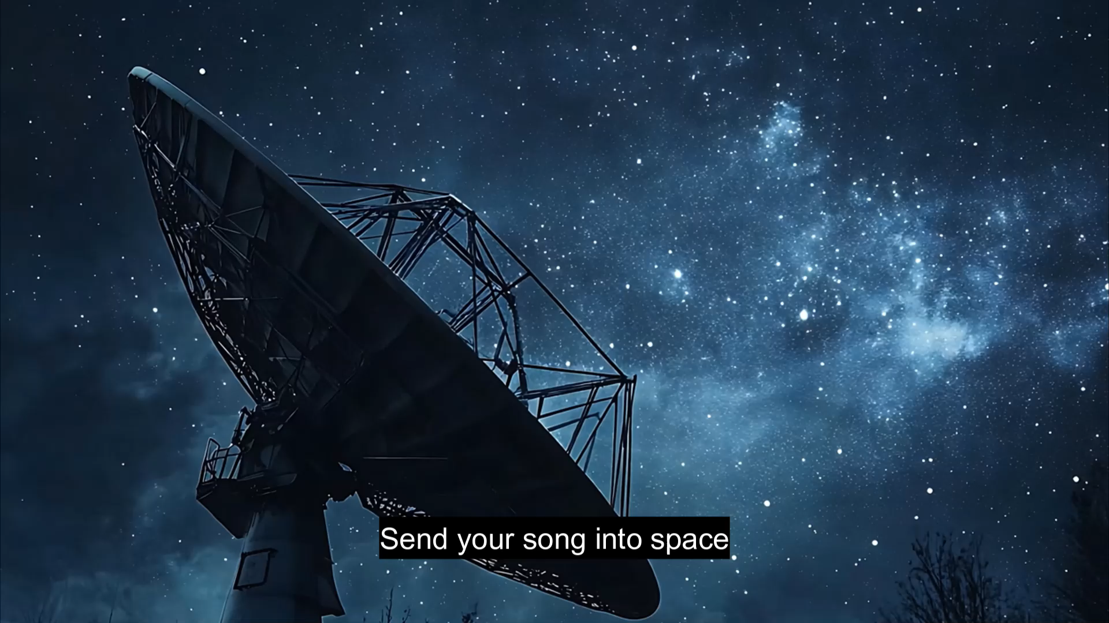

Slide 3


Our solution
Use the music as a universal language
Use the music as a vehicle to learn, so... let’s create songs dedicated to exoplanets!!
We can make it a bit more funny. Let's create a competition.
Let’s create the music2space Global Awards and sent into Space!!

Slide 4
Our intention
Outputs | Outcomes | Impacts
The students investigate the knowledge of exoplanets to create a song. Schools join the initiative by generating a project within the school that involves different teachers and students. Schools participate in the World Astronomy Day (MFS Awards Event) | A platform of songs created by students dedicated to exoplanets is generated. Students show greater interest in STEAM (Science, Technology, Engineering, Art, Art, Mathematics) skills, more specifically in astronomy. | Teachers generate greater learning contexts. Scientific vocations are awakened.
Reality
Lack of knowledge about exoplanets.
Difficulties to generate learning contexts
Opportunities
Connect all the educational communities
Promote competences / Project-base learning
Challenge: connection of humanities and science

Slide 5
How we are going to do it
Phase 0:
Development
Collaboration agreements
Communication plan
Previous phase:
Launch campaign Online and offline Adhesion of the centers
Preparation of educational projects
Execution phase:
Implementation of educational projects. Access to the platform.
Songs through streaming platform.
Evaluation of songs under a mix of criterio
Choice of featured songs
Studio recording.
Final event: M2S Awards.
Outputs
Outcomes
Impacts
Evaluation

Slide 6
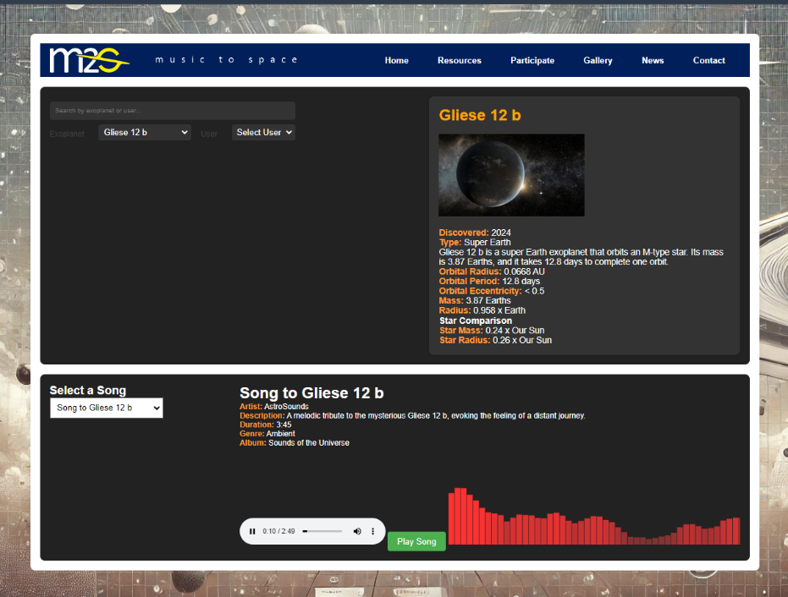
How we are going to do it
Web application
Research
Choose one exoplanet and create your song
Upload and share it!
Streaming partnership

Slide 7
Project planning
Invest: 335.000 € first year
MVP Development:
8 months, 1 team, 6 members (1 team leader 25%, 1 architect 50%, 1 AI expert 50%, 1 front-end, 2 back-end), 5.000h, 175.000 € average internal cost
Infrastructure: 10.000 € / year
Marketing / merchandising / difussion: 150.000 €
Partnership / Collaborations / Alliances:
Streaming platforms: Spotify, Apple Music, Amazon Music, …
Music companies: UMG, Sony, EMI, Warner Music Group, …
Roadmap:
Jan 2025
Start
Oct 2025
Launch / US country
2026
3 countries
2027
Global launch

